Slide 1
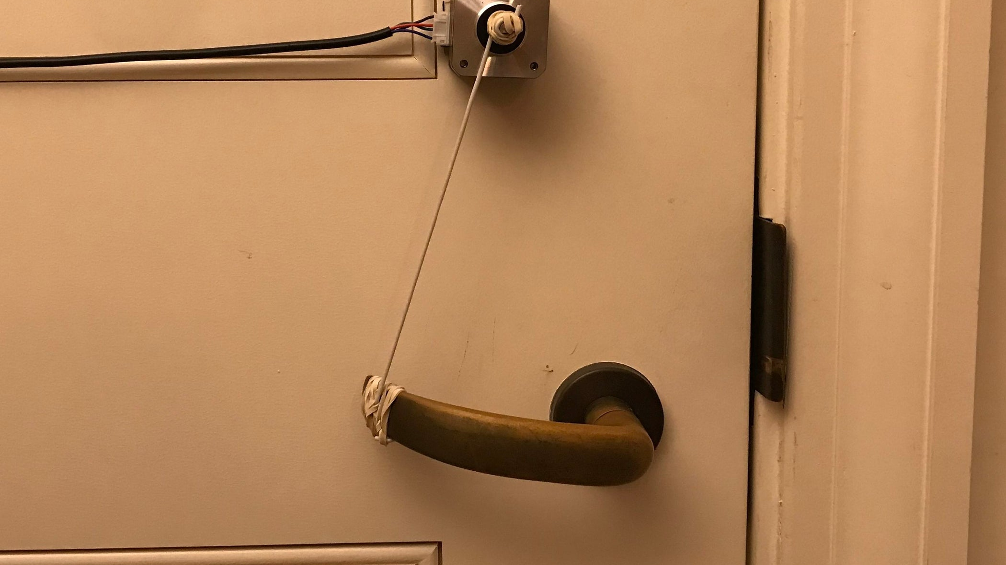
Program a Push Button to Control Stepper Motor - Arduino
By: Yunas Magsi – 101115159
For: Technical Memo – SYSC3010

Slide 2

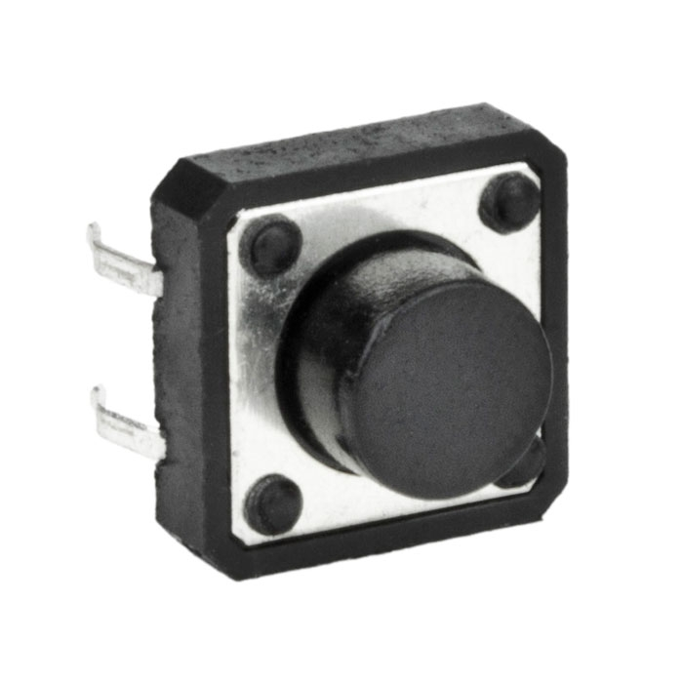
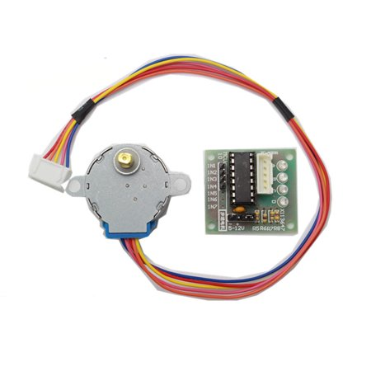
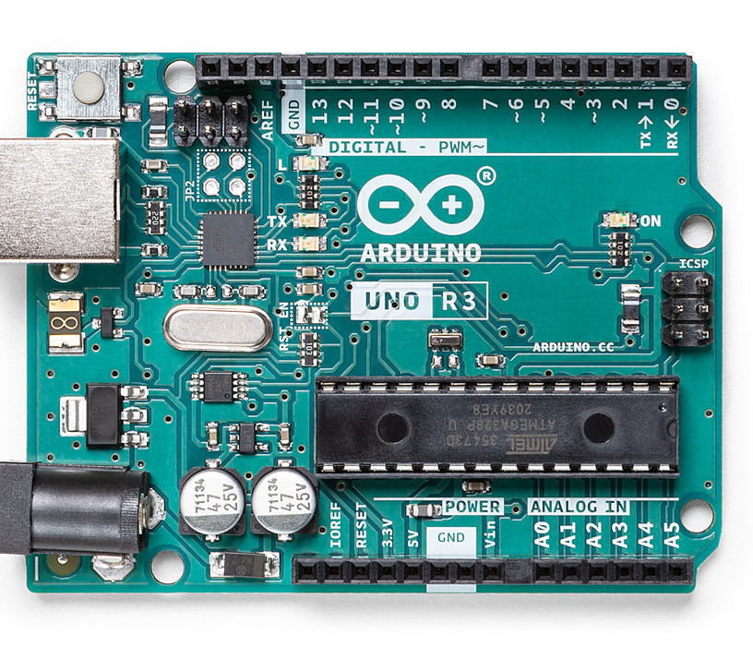
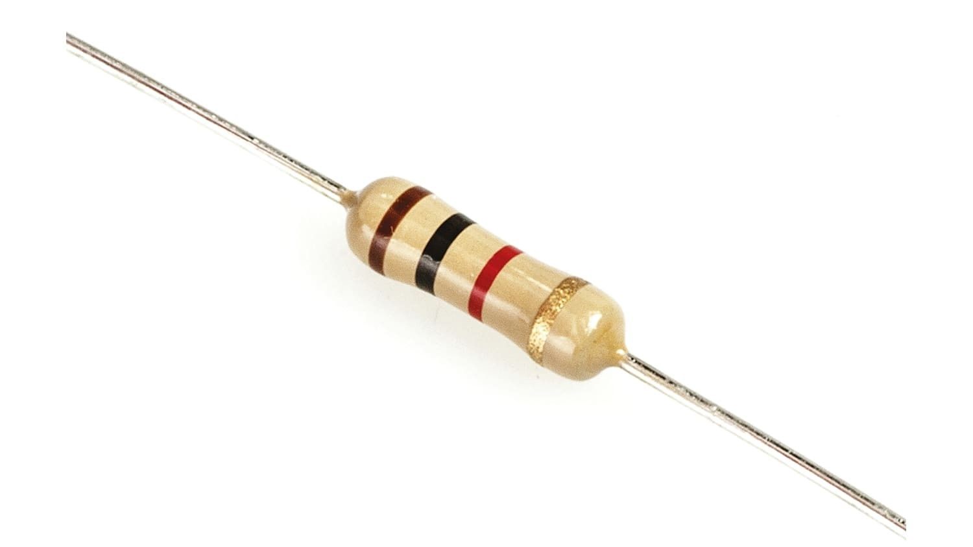
Part Needed
Computer
Arduino
Push Button
10k Ohm Resistor
DC 5V Stepper Motor + ULN2003 Driver

Slide 3
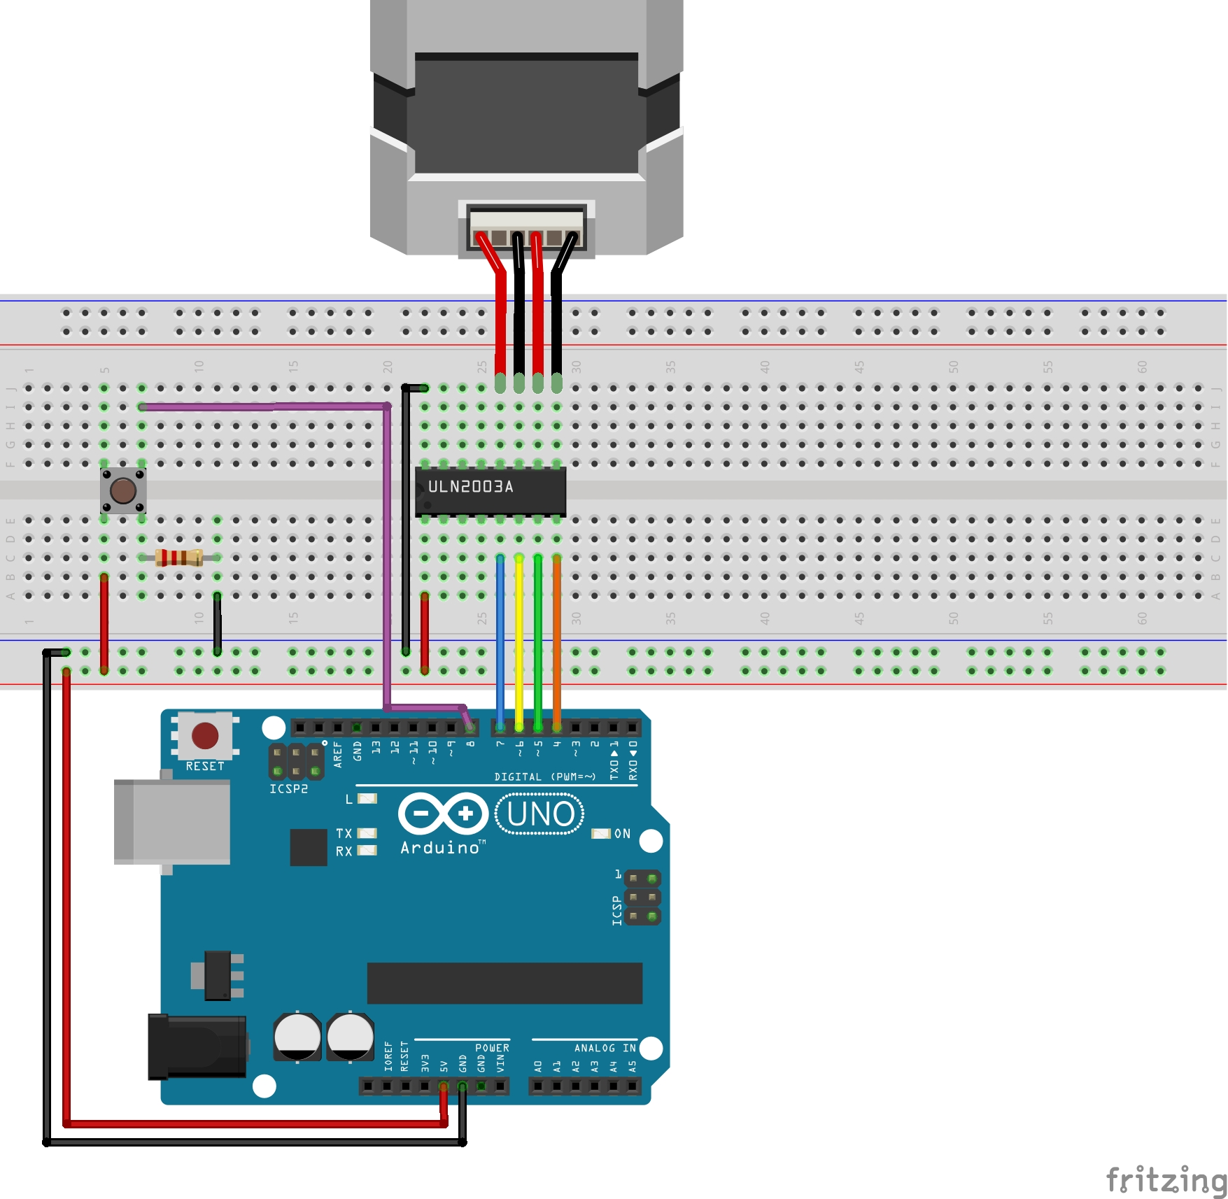
The Wiring

Slide 4
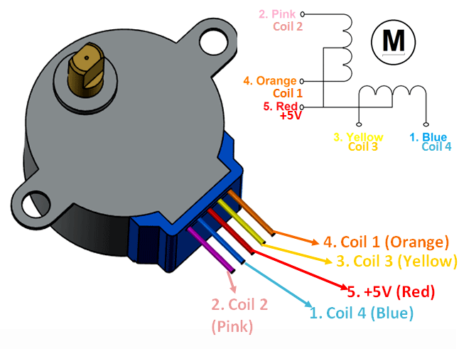
Deeper Look into Stepper Motor(28byj-48)

Slide 5
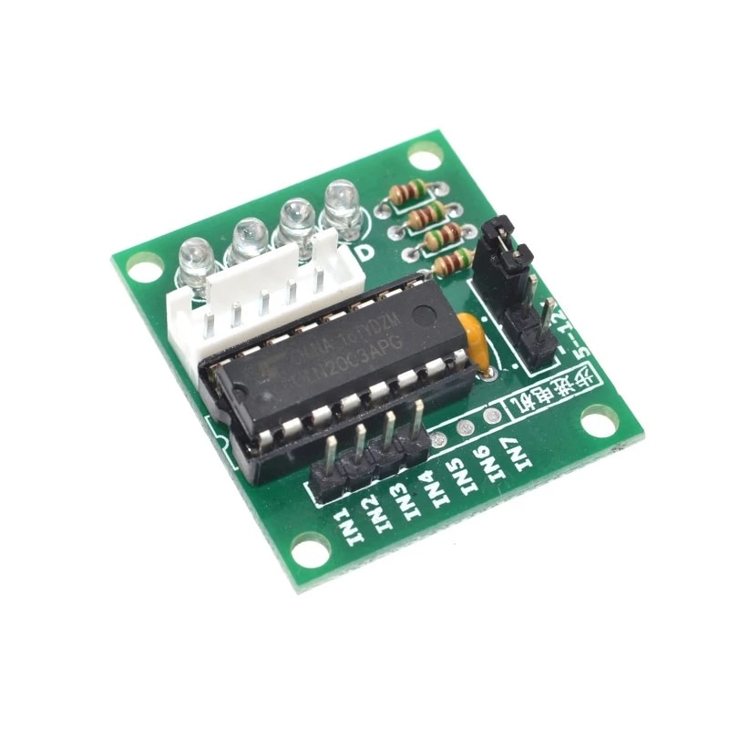
Deeper Look into Stepper Motor Driver (ULN2003)

Slide 6
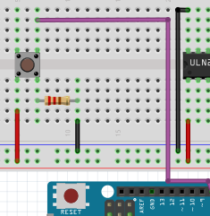
Deeper Look into Push Button

Slide 7

The Coding

Slide 8
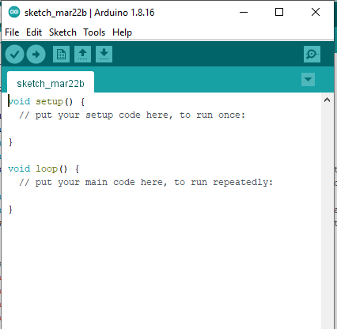
Fire up Arduino Ide

Slide 9
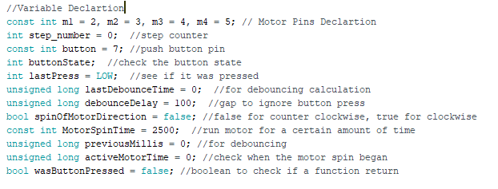
Variable Declaration
All initializing

Slide 10
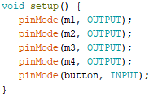

Setup Function
Runs only once

Slide 11
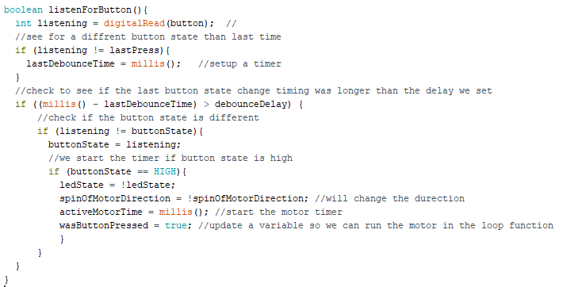
Check For Button Press
Derived From Arduino Debounce Example

Slide 12
Why so Complicated? ¯\_(ツ)_/¯
To Reduce Noise (._.")

Slide 13
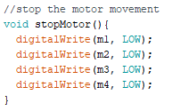
Stop the Motor

Slide 14
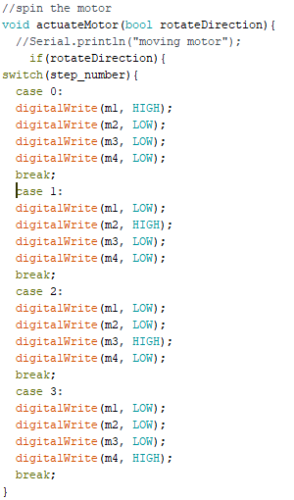
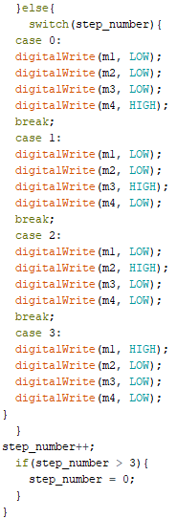
Moving the Motor
Derived from Nikodem Bartnik (via: https://youtu.be/avrdDZD7qEQ)

Slide 15
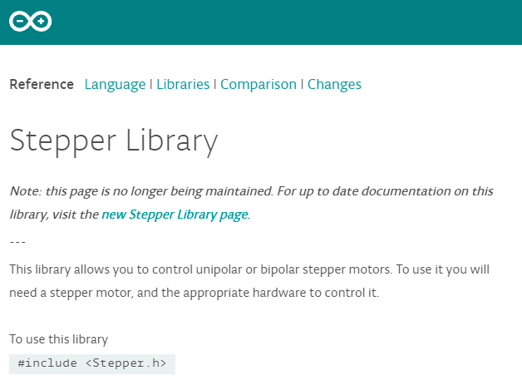
Stepper Motor Library

Slide 16
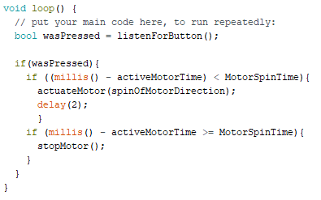
Loop Function

Slide 17

What is this millis()
Cheat Cheat to Threading an Operation

Slide 18

The End Result

